Slide 1
Introduction to Computers

Slide 2
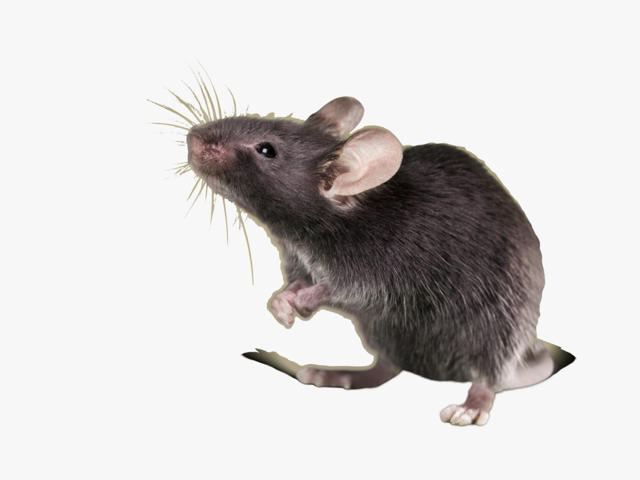

Slide 4
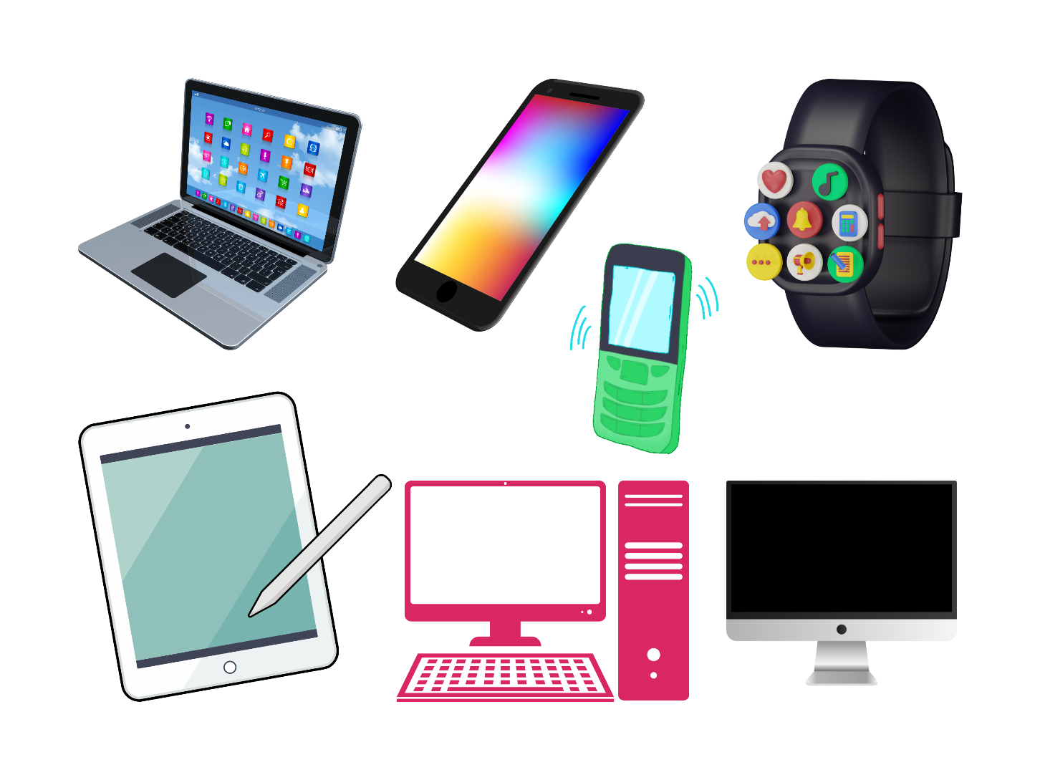
What Is Computer?
A computer is an electronic programmable device that accepts data input, processes data, stores it, and outputs information.

Slide 5
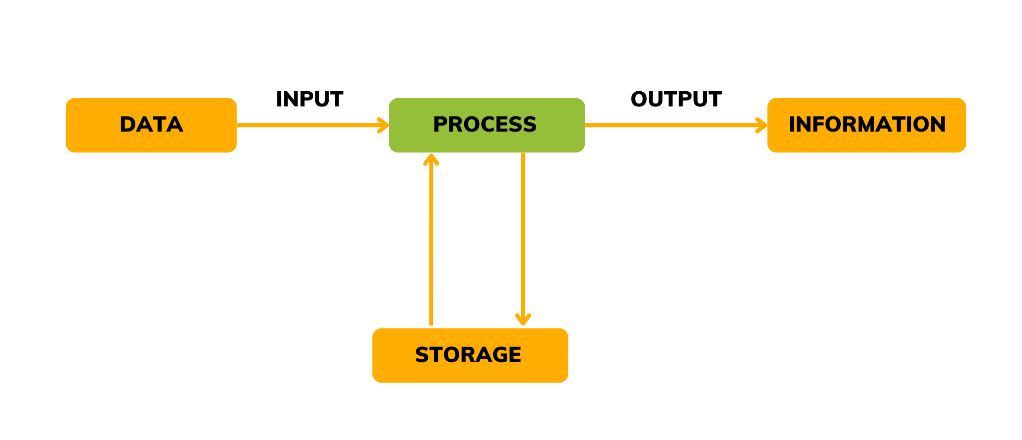
Capability to manipulate, calculate, or transform the input data according to the instructions provided by a program.
Ability of the computer to receive data from external sources (e.g., keyboard, mouse, sensors)
Providing processed data (information) back to the user or another system (e.g., display on a screen, printout)
Ability to retain data, whether temporarily (RAM) or permanently (hard drives, SSDs)

Slide 6
Super Computers
These are high intelligent specialized computers designed to handle sophisticated tasks in large plants.
They can handle large Volumes of scientific computations.
Used in defence, Nuclear plants, climate and weather stations, scientific research, and large manufacturing plants.

Slide 7
Mainframe
Mainframes are powerful computers used for large data processing jobs. They are mainly used by government institutions and large companies for tasks such as census, industry and consumer statistics, enterprise resource planning, and financial transaction processing.

Slide 8
Mini Computers
Mini computers, also known as mid-range computers, are smaller than mainframes but more powerful than personal computers.
Used in manufacturing processes, research laboratories, and small to medium-sized businesses for specific tasks.

Slide 9
Micro Computers
Microcomputers, commonly known as personal computers, are the most common type of computer designed for individual use.
Used for general-purpose tasks such as word processing, internet browsing, gaming, and personal productivity.

Slide 10
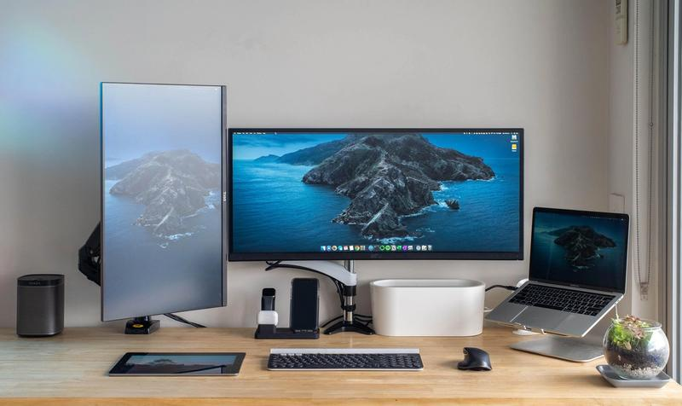
Basic Computer System
A computer system is an integrated set of hardware and software designed to perform data processing tasks.
It consists of input, processing, storage, and output components.

Slide 11
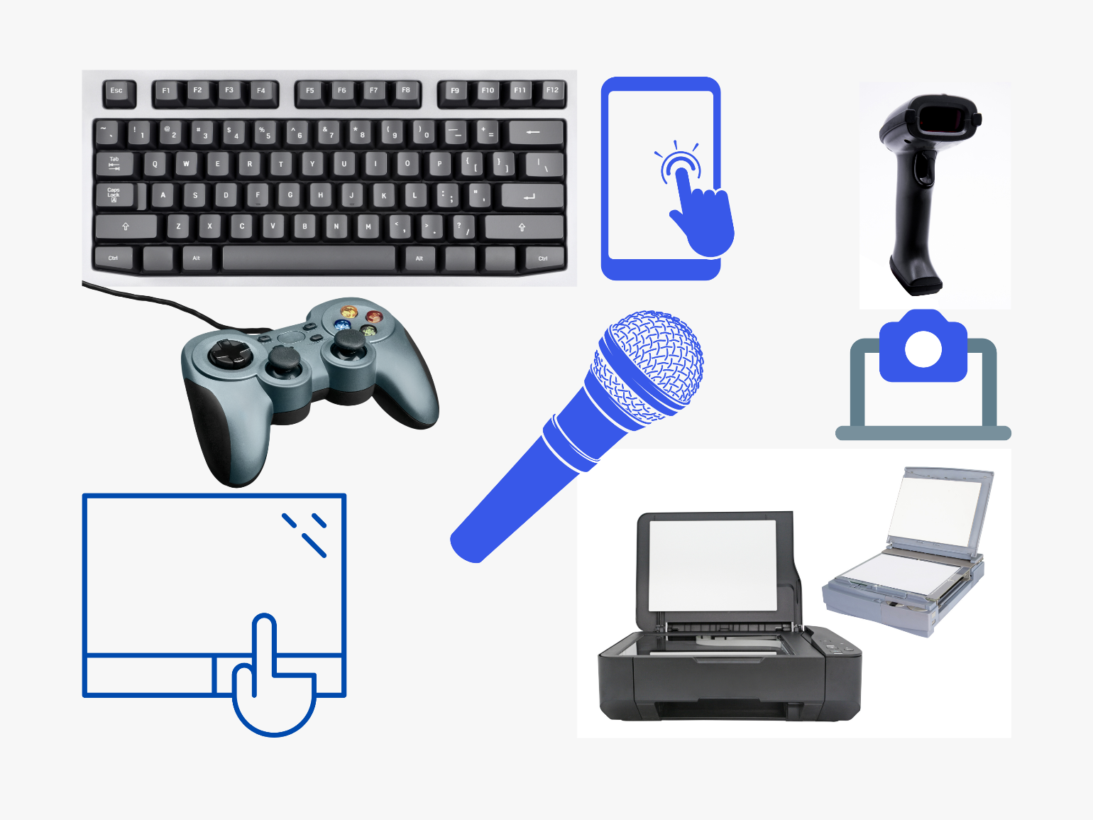
Input Devices
Devices that are used to enter data into a computer.
Examples: Keyboard, touchscreen, barcode reader, gamepad, microphone, digital camera, touchpad, mouse, scanner etc.

Slide 12
Central Processing Unit (CPU)
The CPU is the brain of the computer where data processing takes place.
Control Unit (CU) and Arithmetic Logic Unit (ALU).

Slide 13
3
Memory (RAM)
Random Access Memory (RAM) is temporary storage that holds data and instructions for the CPU.
Provides quick read and write access to a storage medium that the CPU can access directly.
Note: RAM is volatile; data is lost when power is turned off

Slide 14
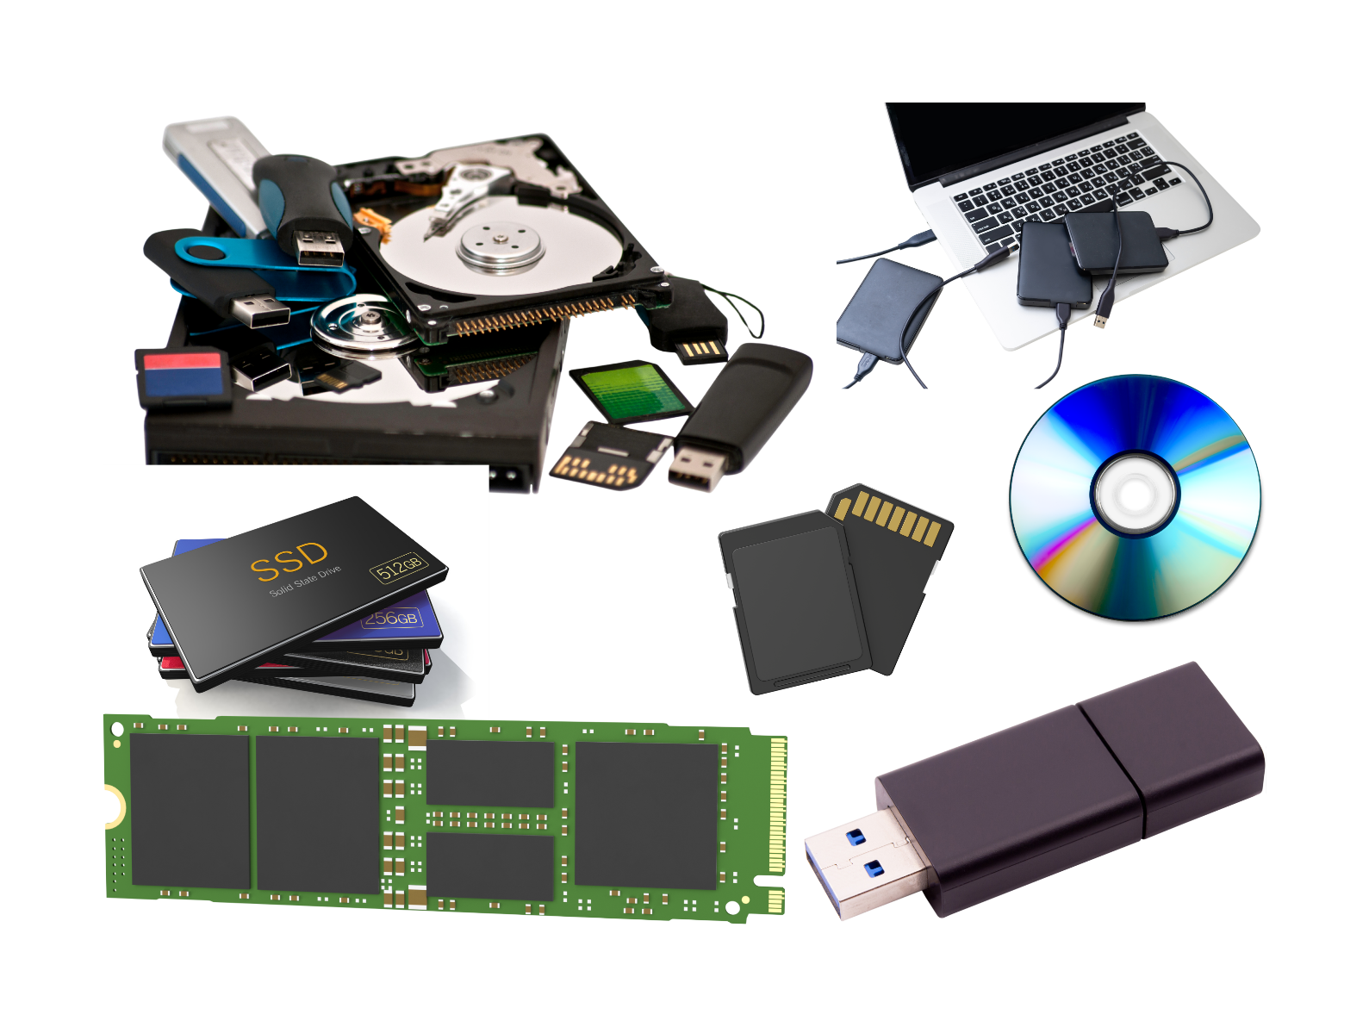
Storage Devices
Devices that store data permanently.
Examples: Hard Disk Drive (HDD), Solid State Drive (SSD), USB flash drives.
Retain data and programs even when the computer is turned off.

Slide 15
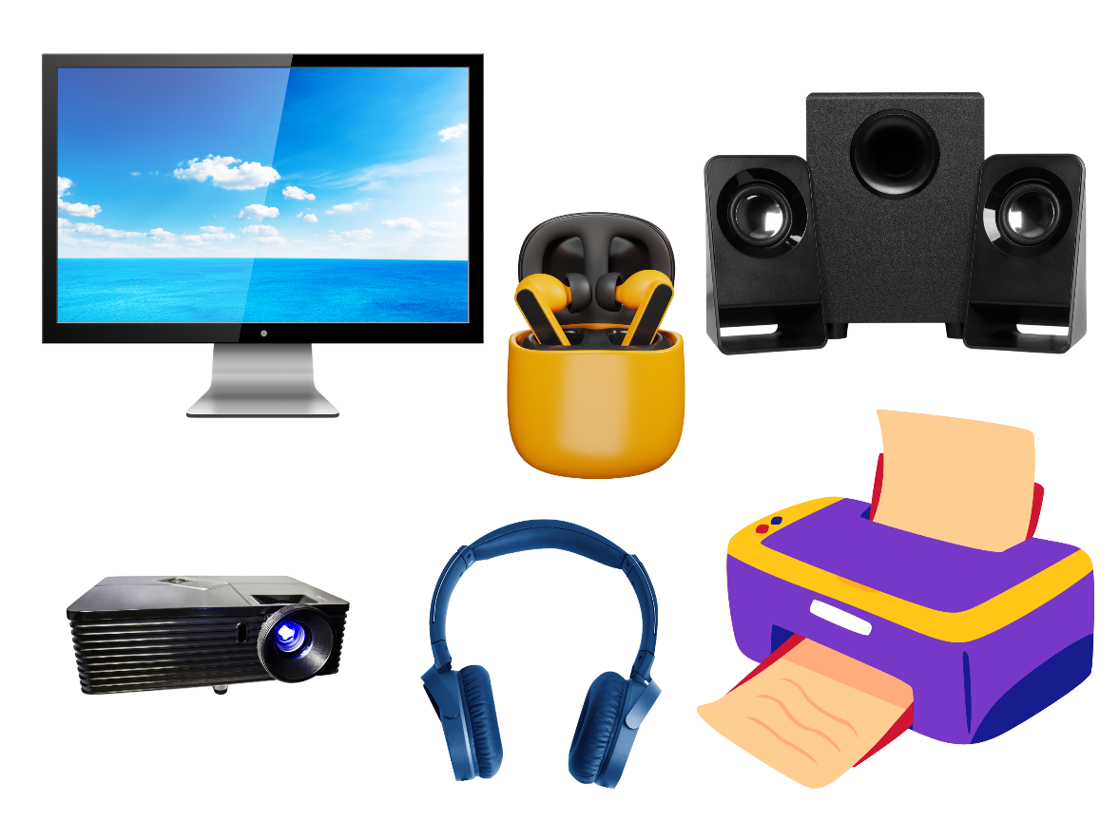
Output Devices
Devices that receive data from the computer and present it to the user.
Examples: Monitor, Earphones, Headsets, Speakers, Projectors, Printer etc.
Converts processed data into a human-readable form.

Slide 16
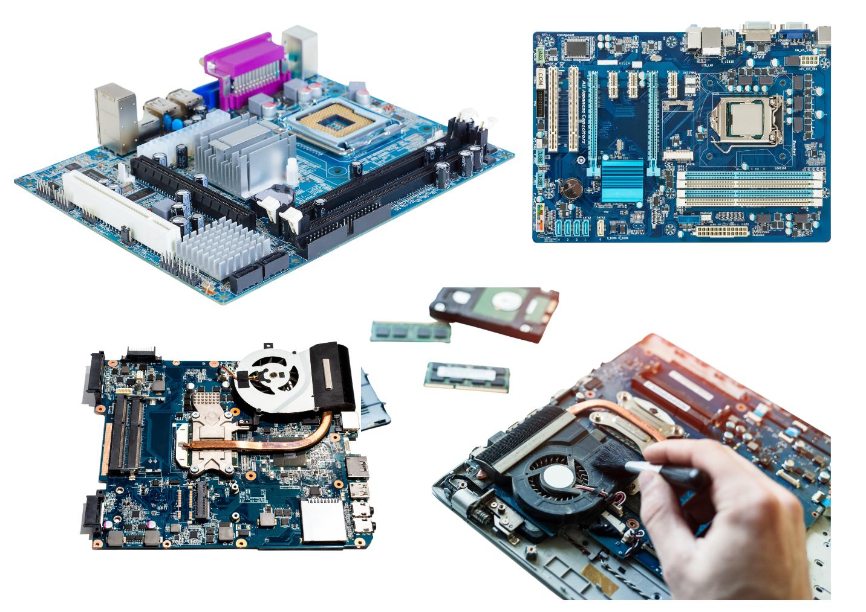
The main circuit board that connects all components of a computer.
Components: CPU, RAM slots, expansion slots, storage connectors, and various ports.
Allows communication between the CPU, memory and other hardware components.
Motherboard

Slide 17
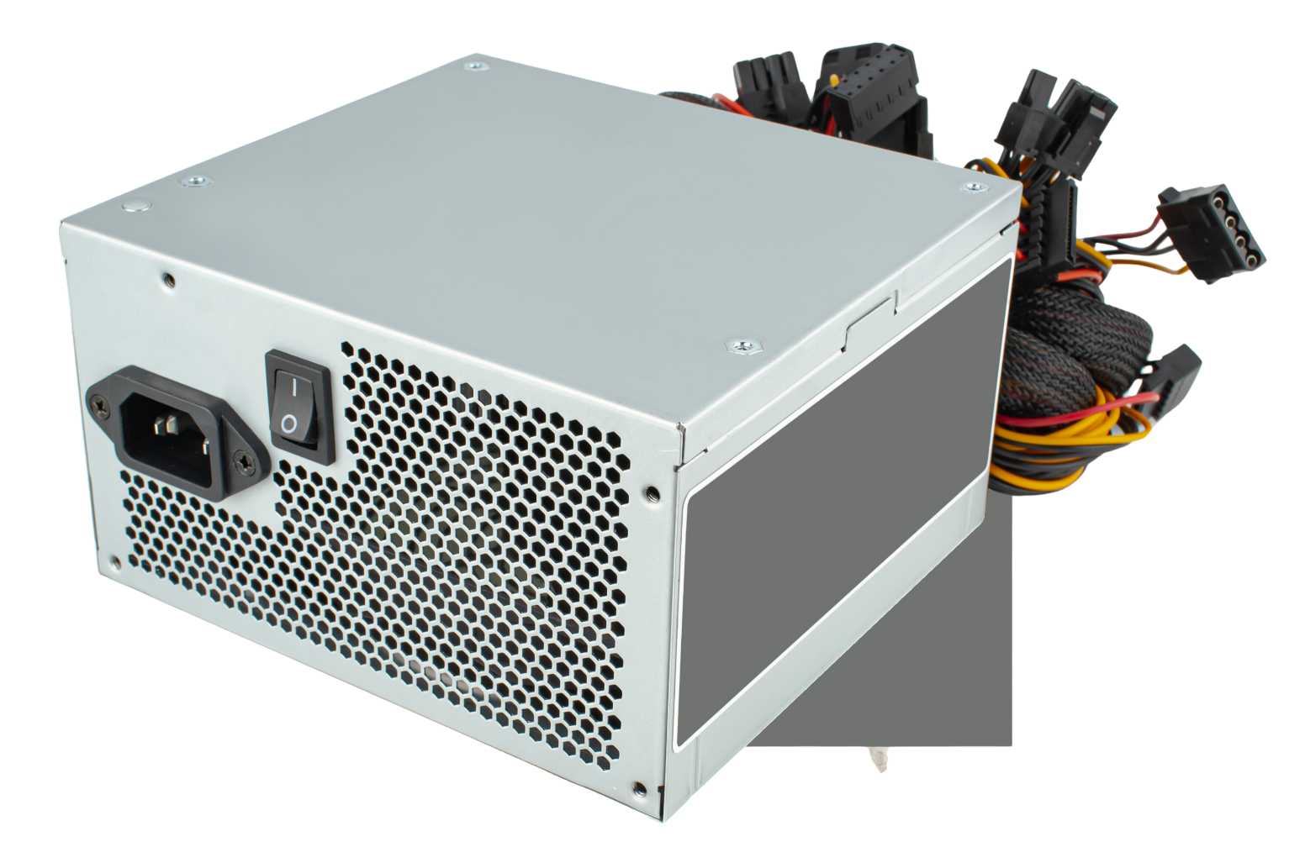
Power Supply Unit (PSU)
Converts electrical power from an outlet into a usable form for the computer.
Supplies power to all internal components of the computer

Slide 18
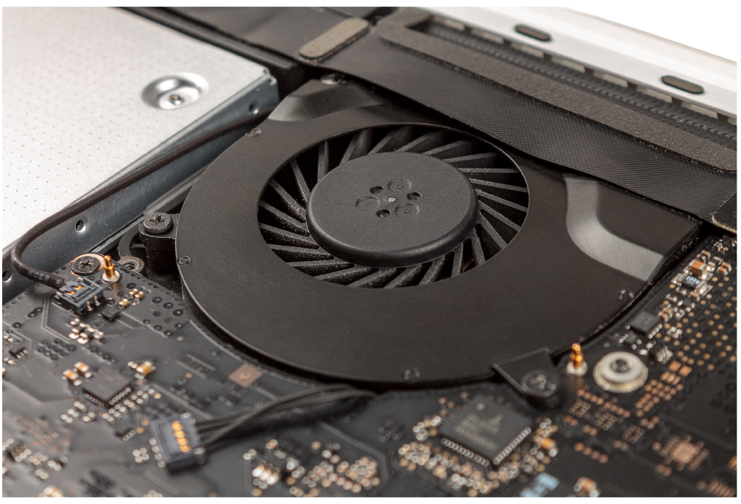
Cooling System
Keeps the computer components cool to prevent overheating.
Components: Fans, heat sinks, liquid cooling systems.
Function: Maintains optimal operating temperatures for the CPU, GPU, and other components.

Slide 19
Questions and Answers

Slide 21
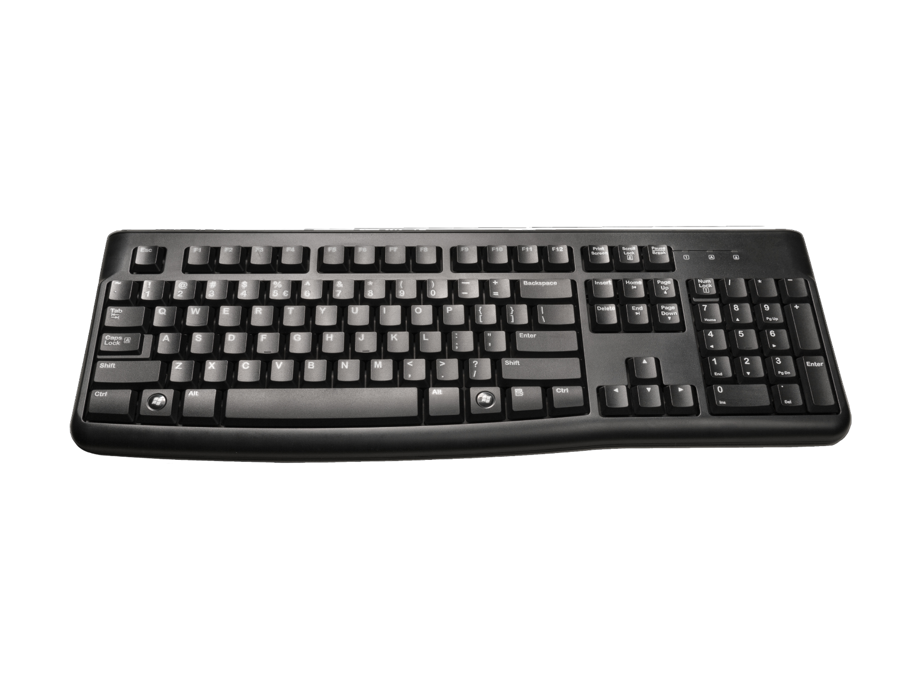
What is this?
Input device or Output device?

Slide 22
What is this?
Input device or Output device?

Slide 23
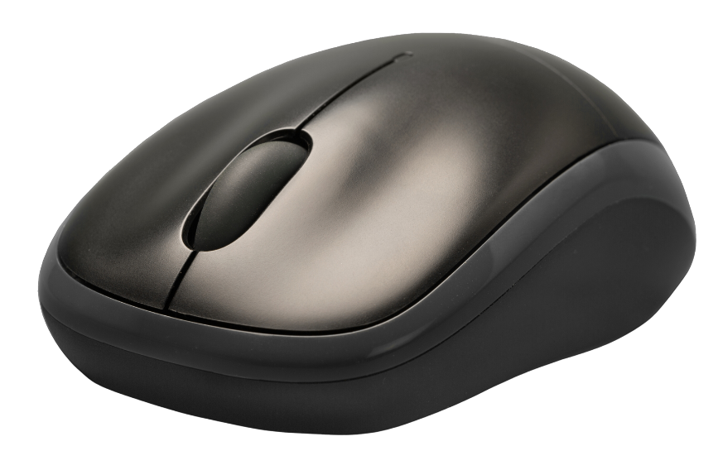
What is this?
Used for?

Slide 24
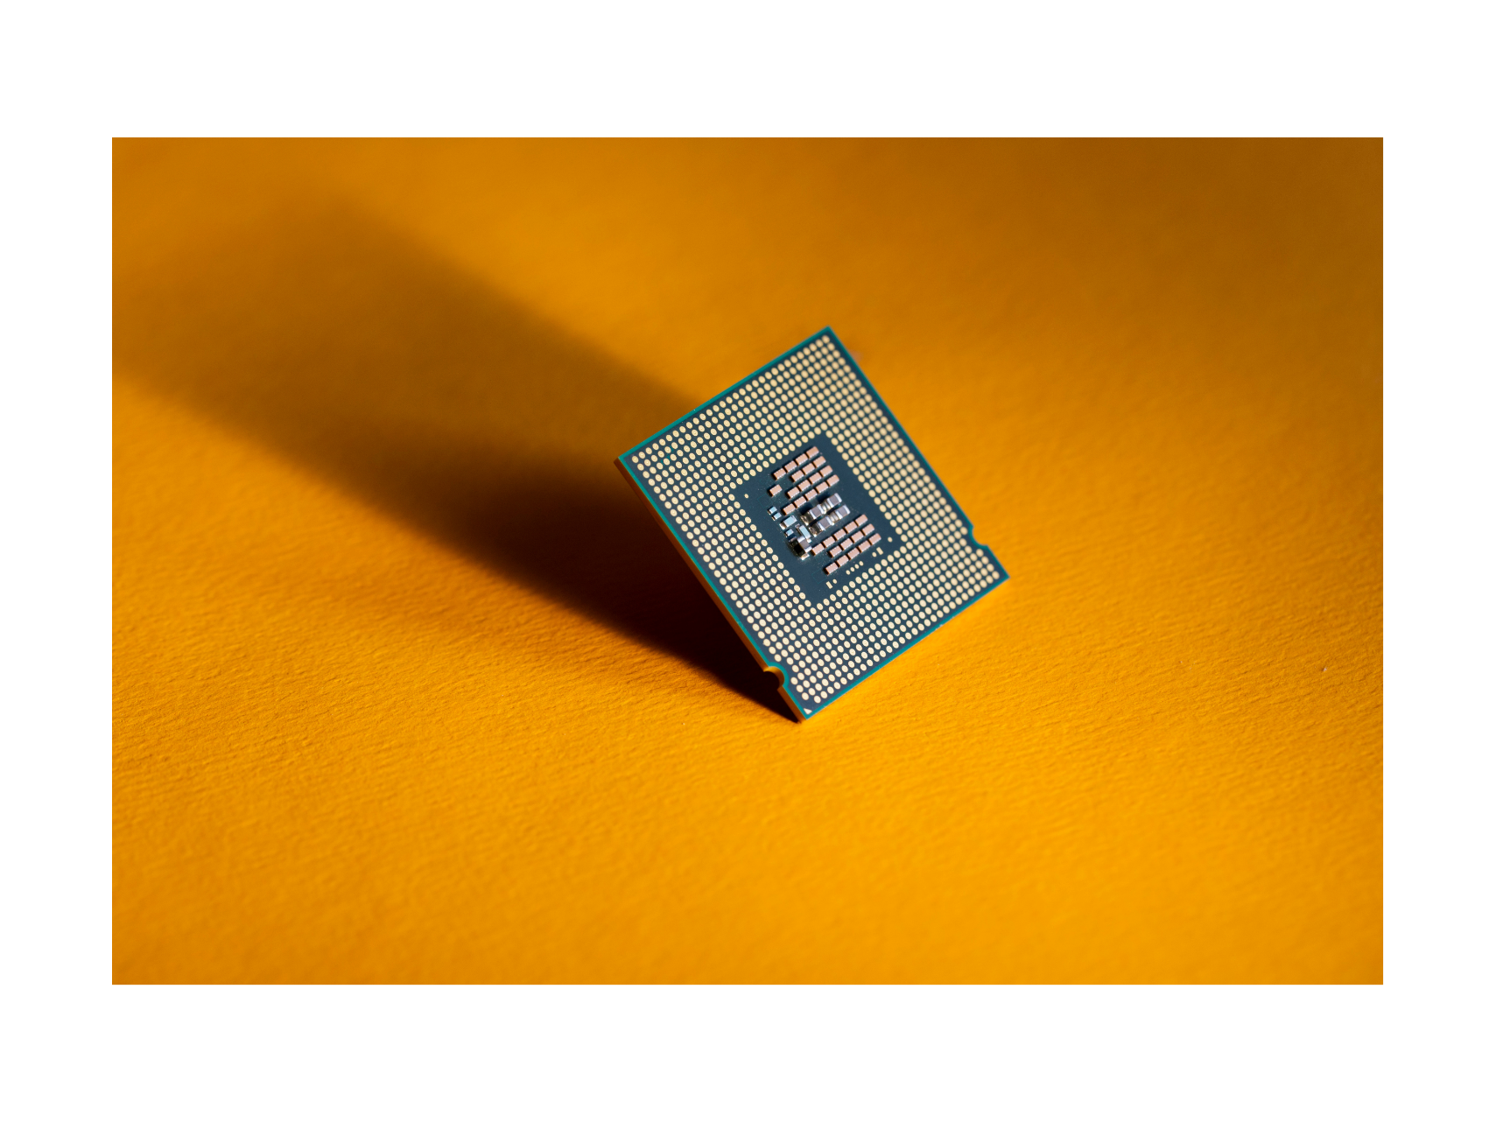
What is this?

Slide 25
What is this?
Output device or Storage device?

Slide 26
True or False

Slide 27
A barcode reader is an example of an output device.

Slide 28
RAM is used for permanent data storage.

Slide 29
The motherboard is the main circuit board that connects all computer.

Slide 30
The PSU converts electrical power from an outlet into a usable form for the computer.

Slide 31
A scanner is an example of an input device.

Slide 32
Thanks
For Joining Us
Designed and Presented by Moses Ssebuwufu

